Slide 1
Comprehensive Digital Marketing
Project Work
Team Details
Team lead – : Parapati Divakara Rao
Team members – : Gude Ravi Teja
: Kottana Madhu
: Sarayapalli sai
: Kandipilli Tarun kumar
Team ID : LTVIP2023TMID11237

Slide 2
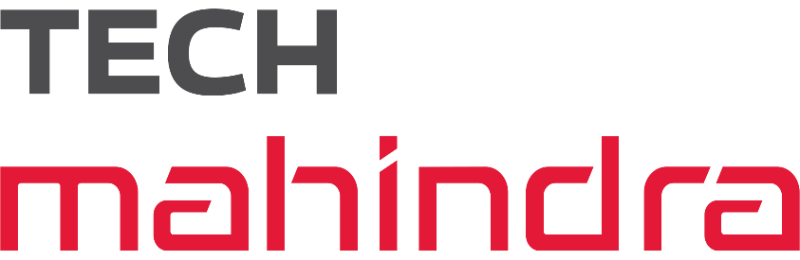
About Our Project
Company / Topic for project: TECH MAHINDRA LTD
Research Brand Identity:
Brand logo:
Brand colours : Red and Black
Brand tagline : ‘connect world connected solutions
Brand’s website : https://www.techmahindra.com

Slide 3
Brand Study Of TECH MAHINDRA Ltd
About the Logo Of Tech Mahindra Ltd :-
The TECH MAHINDRA is a celebration of the Brand's progress and innovative approach.
It is a great symbol of a powerful company with a bright future and values of its heritage.
The Icon is the modern abstract representation
of the letter T

Slide 4
Brand Study of Tech mahindra Ltd
About the Logo Of Tech mahindra Ltd :-
The Icon Communicates a sense of Engineering and Intelligence. The Red Colour in the Logo Shows the Continuity, Change and also Confidence.
The Red Colour in the Logo’s Symbol Shows the Indication of Fuel or Fuel Level
The Black Colour indicates the type of powerful Engine used and the Experienced Tech they use.
The Logo is Geometrical and Sharper.

Slide 5
Brand Study Of Tech mahindra Ltd
About the Mission Of Tech mahindra Ltd :
HMC group of Companies aspires to deliver the best and the most cost-effective products & solutions empowered by superior technologies.
The Group is committed to ensuring value for money by developing high-quality, environment-friendly and efficient solutions that fulfil the diverse needs of customers.
At Hero Motors, we are committed to give our best and Achieve the Highest Standards in Performance, Quality, Systems, Care and Relationships. And then we want to beat these High Standards and go further because anything that can be done can be done better.”

Slide 6
Brand Study Of Tech mahindra Ltd
About the Vision Of Tech mahindra Ltd :
HMC group of Companies aspires to deliver the best and the most cost-effective products & solutions empowered by superior technologies.
Re-define Mobility through the creation of a Mobility Roadmaps
Set best practice and Benchmarks for the Industry.

Slide 7
Competitor Analysis of tech mahindra Ltd
About the Other Competitors With Tech mahindra Ltd :-
Tech mahindra Many Competitors Across India they are as follows :
wipro
Tata Consultancy services
HCL Tech
IBM
INFOSYS
CAPGEMINI

Slide 8
Target Audience
Target Audience
TECH MAHINDRA is Targeting Audience Mainly Through :
STOCKPRICE TRAGET FOR TECH MAHINDRA LIMITED TECHM ARE 1226.8 ON DOWN SIDE AND 1243.7 ON UP SIDE
Young boys in the Age B.etween 19 – 30 years old.

Slide 9
SEO
Analyzing SEO of TECH MAHINDRA :
TechM is looking for an awesome search engine optimization specialist to help potential customers . Customer's website does not currently rank at all in the top 50 on Google, Yahoo, or Bing, so they want to find someone that can provide a detailed action plan of how they will gain a lot more organic visibility.
Its organic traffic is 3,233,074 sessions per month.
The stats are high compared to their SEO performance in June 2023
heromotocorp.com – Uber suggest Traffic Analyzer Backlinksheromotocorp.com – Uber suggest Backlinks Hero MotoCorp gets backlinks from 639,634 unique domains, increasing the Domain Authority of Hero’s domain and helping it rank higher.

Slide 10
RESPONSIBILITIES
Responsibilities:
- Create a full action plan for our domain's SEO, including:
- Analyze competitor websites for organic traffic insights
- Determine the best keywords to focus on throughout campaign
- Optimize content
- Perform on-page and back-end optimizations for better rankings
- Provide regular updates throughout the process
- On-page Optimization

Slide 11
Keywords Research
OBJECTIVES FOR KEYWORD RESEARCH :
ITE TRAFFIC:
.1Preparing Research App Store Keywords
When you are working on App Store Optimization Services, in order to help you choose the best App Store keywords in Google Play or Apple App Store , it is worth studying this report carefully. This keyword research report about “tech mahindra” will use the data collected by ASOTools for a comprehensive analytic. For example, long tail keyword data: “فيس بوك”, “capital one. 360”, “bit torrent”, “extreme”, “تقویم ۹۹”, “biryani”.
2.Research Keyword “tech mahindra” with Google Play Data
Extended Long tail words
Obviously, once the root of the core keyword is determined, you need to expand more long tail words. For example, I have collected the top 5 long tail words related to the keyword tech mahindra from the ASOTools

Slide 12
Keywords Research
PROCESS OF CONDUCTING KEYWORD RESEARCH:
As of my last knowledge update in September 2021, I don't have specific information about Tech Mahindra's research projects related to keyboards or any recent developments in this area. Tech Mahindra is a large IT services and consulting company, and their research efforts can span a wide range of technology areas.
If you are looking for information about their keyboard-related research, I recommend visiting their official website, checking their research publications, or reaching out to their research and development department directly. They may have released new information or research findings since my last update.

Slide 13
Keywords Research
PROCESS OF CONDUCTING KEYWORD RESEARCH:
3. Shifting search trends :
Search trends and user behavior change over. Staying up-to-date with the latest trends and adjusting your keyword strategy accordingly is crucial
4. Lack of user intent understanding :
Merely identifying keywords without considering user intent can lead to suboptimal results. It's important to understand the intent behind a keyword search to provide the most relevant content and capture the right audience

Slide 14
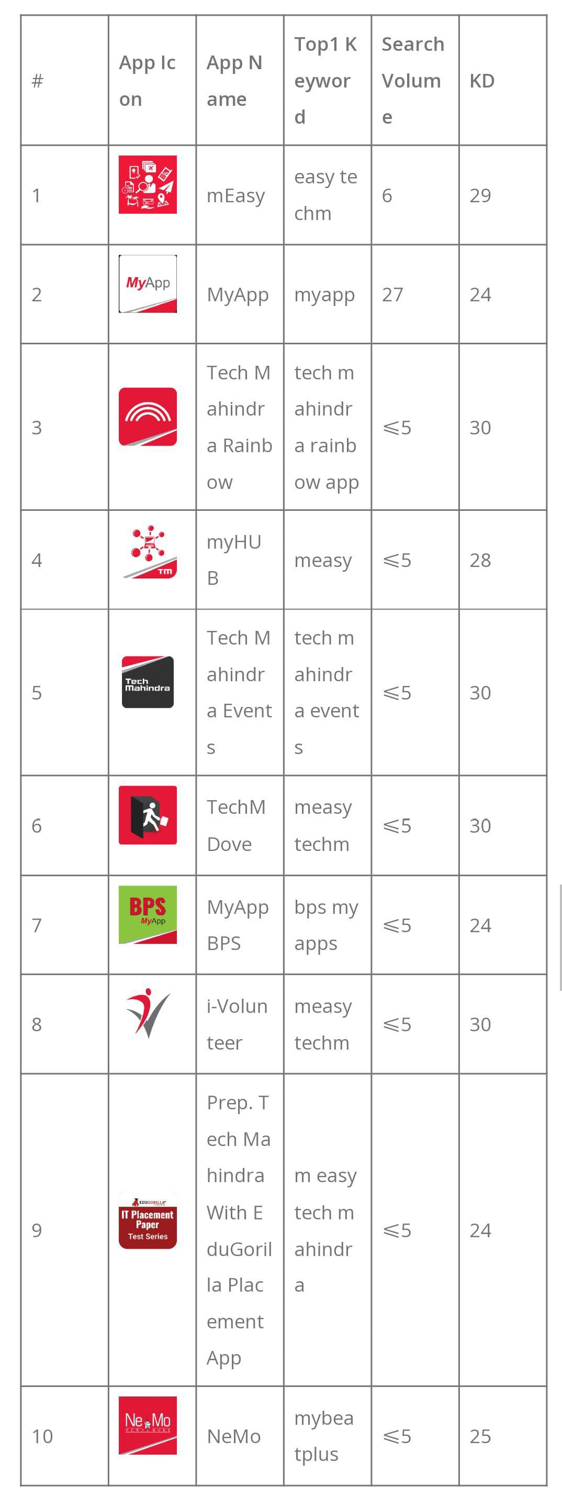
Keywords Research

Slide 15
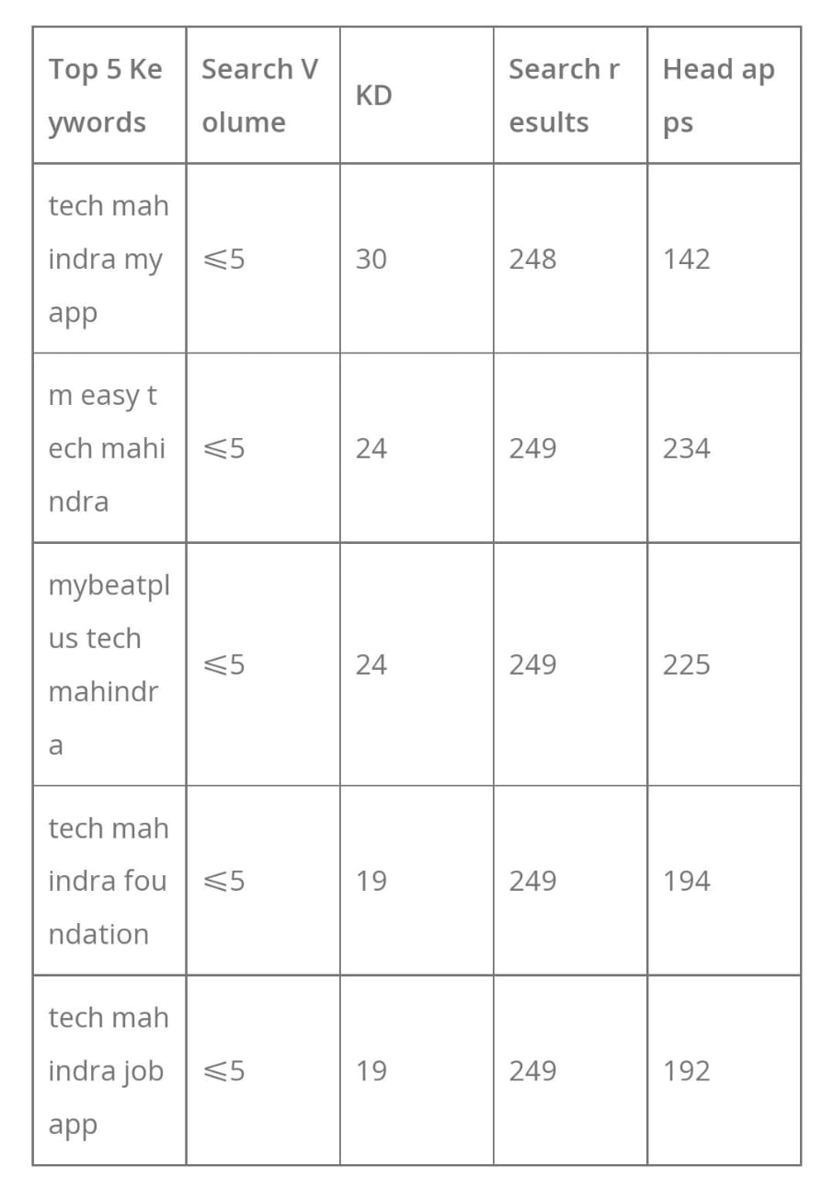
Keywords Ideas

Slide 16
Content Ideas
MARKETING STRATEGIES
Tech Strategy: Fully integrated Digital Marketing Technology (DMT) stack, with access to Unified Customer profile across all the touch-points to deliver Next Best Experience at scale and drive data-driven marketing automation.
Business Goals: Improve the overall customer experience across all the digital channels in compliance with legal regulations. Eventually, improve revenues from the digital channels and optimize marketing efforts
Optimization Areas: Reduce Time to Marketing, Delivery right content at the right time and channel, adopt agile way of working while automating the operations.

Slide 17
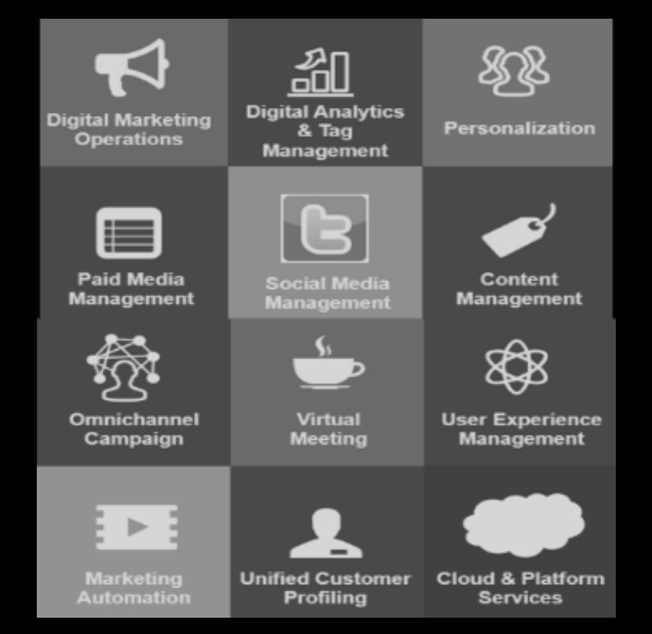
Content Ideas

Slide 18
Marketing Strategy
Hero MotoCorp Marketing Strategies :
Use of Influencers :
Hero MotoCorp partners with influencers to promote their products on social media. This helps to reach a wider audience and generate excitement for their brand.
For example :
On Instagram, Hero MotoCorp has partners with a number of Indian celebrities and social media influencers to promote their motorcycles. For example, they have teamed with bike with girl, an Instagram influencer with a massive following of 1.2 million people.

Slide 19
Marketing Strategy
Hero MotoCorp Marketing Strategies :
3. Paid Advertising Or Native Advertising :
Native Advertising is a Type of Advertising that is Designed to Blend in with the surrounding content.
Campaign :
Hero MotoCorp partnered with the Indian news website NDTV to create a native advertising campaign for its Hero Xtreme 160R motorcycle. The campaign featured a series of articles and videos about the motorcycle, which were published on NDTV’s website and social media pages.

Slide 20
Marketing Strategy
Hero MotoCorp Marketing Strategies :
The articles and videos were written and produced by NDTV’s Editorial Team, but they were sponsored by Hero MotoCorp. Why it’s a Good example of native advertising : The campaign was effective because it was seamlessly integrated into NDTV’s existing content.
The articles and videos were well-written and informative, and they did not feel like traditional advertisements.
As a result, they were more likely to be read and watched by NDTV’s audience.

Slide 21
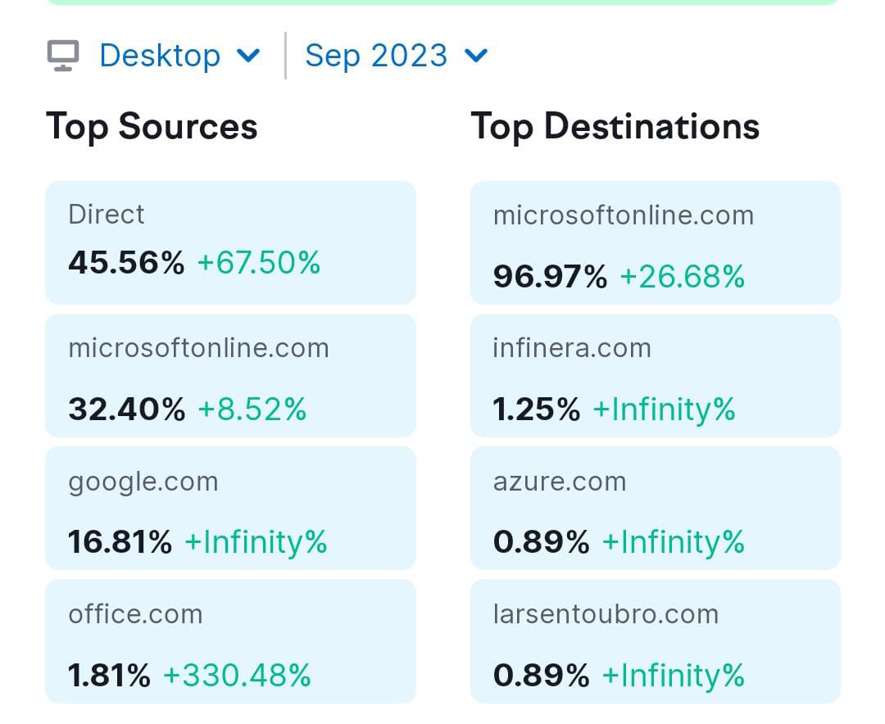
Website Traffic

Slide 22
Content Creation
ch Mahindra, as an IT services and consulting company, may engage in content creation across various areas, including thought leadership, marketing, and industry-specific content. Content creation can encompass blog posts, whitepapers, case studies, videos, webinars, social media content, and more. Here are some common types of content Tech Mahindra might create:
1. **Thought Leadership:** Tech Mahindra may publish articles, whitepapers, and reports on emerging technologies, industry trends, and digital transformation strategies.
2. **Case Studies:** They might produce case studies highlighting successful client projects and solutions they've provided.
3. **Blogs:** Tech Mahindra's website may feature blogs discussing relevant industry topics, best practices, and insights.
4. **Webinars and Podcasts:** They could host webinars and podcasts to discuss technology trends, innovations, and solutions.

Slide 23
Content Creation
Social Media Content: Tech Mahindra might use platforms like LinkedIn, Twitter, and others to share industry news, company updates, and thought leadership pieces.
Videos: They may create videos showcasing their services, client success stories, and technology demonstrations.
Infographics: Visual content such as infographics to simplify complex topics or data.
Press Releases: Official announcements about partnerships, acquisitions, product launches, or significant company news.
To find specific content created by Tech Mahindra, you should visit their official website and explore their blog section, resources, or news updates. Additionally, you can follow their social media profiles and subscribe to their newsletters to stay updated on their latest content. Keep in mind that the specific types and topics of content they create may evolve over time.

Slide 24
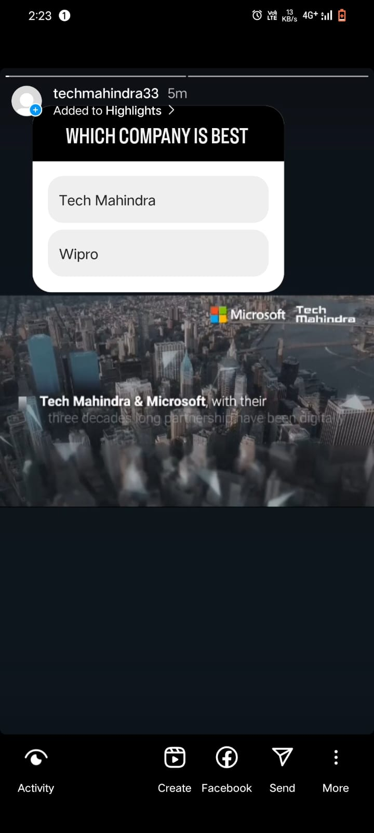
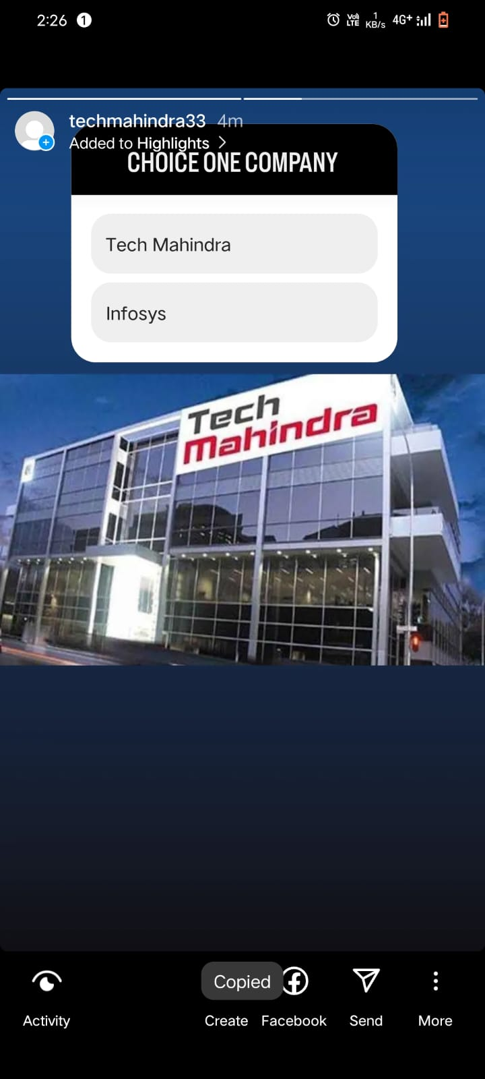
INSTAGRAM STORY
https://instagram.com/stories/techmahindra33/3212561220519972189?utm_source=ig_story_item_share&igshid=NjZiM2M3MzIxNA==
https://instagram.com/stories/techmahindra33/3212559593960396359?utm_source=ig_story_item_share&igshid=NjZiM2M3MzIxNA==

Slide 25
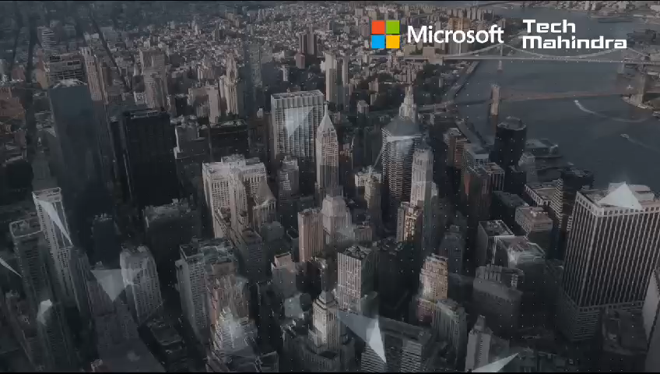

Slide 26
Lessons Learned:
Consistency is Key: Consistency in content creation helps to establish brand recognition and build a loyal audience. Maintaining a consistent brand voice, visual identity, and posting schedule creates a cohesive brand experience for the audience.
Quality Over Quantity: While it's important to consistently create content, focusing on quality should take precedence over quantity. Well-produced and thoughtful content tends to have a more significant impact and can lead to higher engagement and brand loyalty.
3. Building Relationships and Collaborations: Collaboration with influencers, partners, or. customers can provide fresh perspectives and expand the reach of the brand's content. Collaborations help tap into new audiences, bring in diverse ideas, and create engaging content.

Slide 27
THE END
PROJECT DONE BY THE TEAM
PARAPATI DIVAKARA RAO (TEAM LEADER)
GUDE RAVI TEJA(TEAM MEMBER)
KANDIPILLI TARUN KUMAR (TEAM MEMBER)
KOTTANA MADHU (TEAM MEMBER)
SARYAPALLI SAI (TEAM MEMBER)

